Slide 1
W4111 – Introduction to Databases: Section 002, Spring 2021 Lecture 12: Isolation, CAP, Big Data
© Donald F. Ferguson, 2021

Slide 2
W4111 – Introduction to Databases: Section 002, Spring 2021 Lecture 12: Isolation, CAP, Big Data
We will start in a couple of minutes.
© Donald F. Ferguson, 2021

Slide 3

Contents

Slide 4
Contents
There will be some written questions on the take home final exam.
You can look up the answers.
The purpose is to just reinforce basic concepts.
A Quick Completion of Transactions:
Isolation, Serializability, Aborts, Deadlock
CAP “Theorem”
ACID versus BASE
A Quick Overview of Big Data:
ETL, Data Warehouse, Data Lake
Map-Reduce, Hadoop
Apache Spark
Online Analytical Processing – OLAP
Start Schema; Facts and Dimensions
Cubes
Operations
Pivot Tables
Discussion, End of Semester Roadmap

Slide 5
Transactions Isolation Recovery
CAP, BASE
Scaling Models

Slide 6
Reminder
Transactions Isolation Recovery

Slide 7

Data Management
Find things quickly.
Load/Save quickly.
Control access (Isolation)
Durability
Database Systems: The Complete Book (2nd Edition) by Hector Garcia-Molina (Author), Jeffrey D. Ullman (Author), Jennifer Widom (Author)

Slide 8
Core Transaction Concept is ACID Properties
http://slideplayer.com/slide/9307681
ACID
Atomic
“ALL OR NOTHING”
Transaction cannot be subdivided
Consistent
Transaction → transforms database from one consistent state to another consistent state
Isolated
Transactions execute independently of one another
Database changes not revealed to users until after transaction has completed
Durable
Database changes are permanent
The permanence of the database’s consistent state

Slide 9
ACID Properties (httpwww.tutorialspoint.com/dbms/dbms_transaction.htm)
A transaction is a very small unit of a program and it may contain several low-level tasks. A transaction in a database system must maintain Atomicity, Consistency, Isolation, and Durability − commonly known as ACID properties − in order to ensure accuracy, completeness, and data integrity.
Atomicity − This property states that a transaction must be treated as an atomic unit, that is, either all of its operations are executed or none. There must be no state in a database where a transaction is left partially completed. States should be defined either before the execution of the transaction or after the execution/abortion/failure of the transaction.
Consistency − The database must remain in a consistent state after any transaction. No transaction should have any adverse effect on the data residing in the database. If the database was in a consistent state before the execution of a transaction, it must remain consistent after the execution of the transaction as well.
Durability − The database should be durable enough to hold all its latest updates even if the system fails or restarts. If a transaction updates a chunk of data in a database and commits, then the database will hold the modified data. If a transaction commits but the system fails before the data could be written on to the disk, then that data will be updated once the system springs back into action.
Isolation − In a database system where more than one transaction are being executed simultaneously and in parallel, the property of isolation states that all the transactions will be carried out and executed as if it is the only transaction in the system. No transaction will affect the existence of any other transaction.

Slide 10
Transaction Concept
A transaction is a unit of program execution that accesses and possibly updates various data items.
E.g., transaction to transfer $50 from account A to account B:
BEGIN TRANSACTION {
1. read(A)
2. A := A – 50
write(A)
4. read(B)
5. B := B + 50
write(B)
COMMIT or ROLLBACK }
Two main issues to deal with:
Failures of various kinds, such as hardware failures and system crashes
Concurrent execution of multiple transactions
Reminder

Slide 11
Isolation
Transactions Isolation Recovery

Slide 12
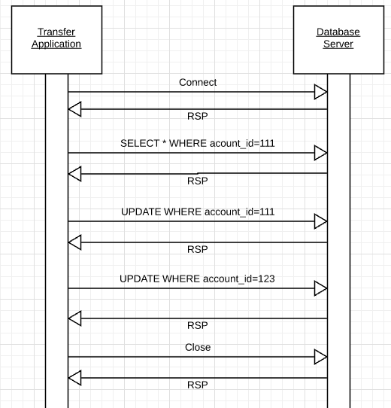
Isolation
Transfer $50 from
account_id=111 to
account_id=123
Requires 3 SQL statements
SELECT from 111 to check balance >= $50
UPDATE account_id=111
UPDATE account_id=123
There are some interesting scenarios
Two different programs read the balance ($51)
And decide removing $50 is OK.
DB constraints can prevent the conflict from happening, but …
There are more complex scenarios that constraints do not prevent.
Not ALL databases support constraints.
The “correct” execution should be that
One transaction responds “insufficient funds”
Before attempting transfer instead of after attempting.
Multiple readers

Slide 13
Isolation
Consider two simultaneous transfer transactions T1 and T2.
There are two equally correct executions
T1 transfers, T2 responds “insufficient funds” and does not attempt transfer
T2 transfers, T1 responds “insufficient funds” and does not attempt transfer
Each correct simultaneous execution is equivalent to a serial (sequential) execution schedule
(1) Execute T1, Execute T2
(2) Execute T2, Execute T1
NOTE:
We are focusing on correctness not
Fairness:
We do not care which transaction was actually submitted first.
And probably do not know due to networking, etc.
Transfer $50 from
account_id=111 to
account_id=123
Requires 3 SQL statements
SELECT from 111 to check balance >= $50
UPDATE account_id=111
UPDATE account_id=123
There are some interesting scenarios
Two different programs read the balance ($51)
And decide removing $50 is OK.
DB constraints can prevent the conflict from happening, but …
There are more complex scenarios that constraints do not prevent.
Not ALL databases support constraints.
The “correct” execution should be that
One transaction responds “insufficient funds”
Before attempting transfer instead of after attempting.
Multiple readers

Slide 14
Serializability
“In concurrency control of databases, transaction processing (transaction management), and various transactional applications (e.g., transactional memory^{[3]} and software transactional memory), both centralized and distributed, a transaction schedule is serializable if its outcome (e.g., the resulting database state) is equal to the outcome of its transactions executed serially, i.e. without overlapping in time. Transactions are normally executed concurrently (they overlap), since this is the most efficient way. Serializability is the major correctness criterion for concurrent transactions' executions. It is considered the highest level of isolation between transactions, and plays an essential role in concurrency control. As such it is supported in all general purpose database systems.” (https://en.wikipedia.org/wiki/Serializability)

Slide 15
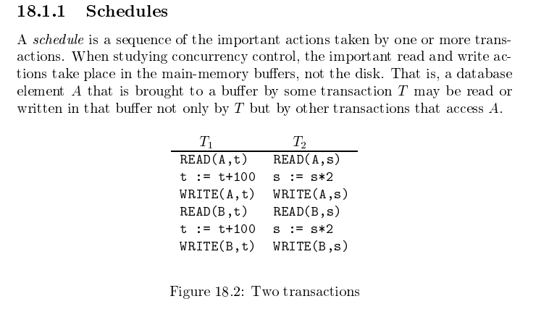
Schedule
Garcia-Molina et al.

Slide 16
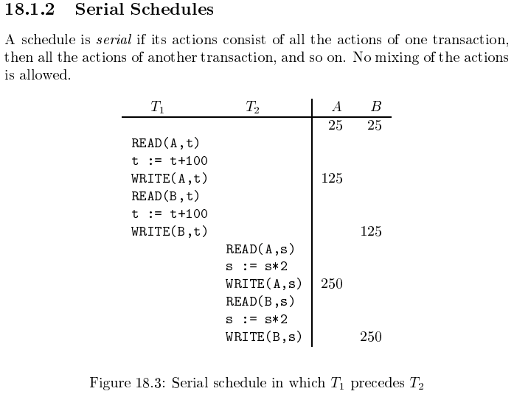
Serializable
Assume there are three
concurrently executing transactions
T1, T2 and T3
The transaction manager
Enables concurrent execution
But schedules individual operations
To ensure that the final DB state
Is equivalent to one of the following schedules
T1, T2, T3
T1, T3, T2
T2, T1, T3
T2, T3, T1
T3, T1, T2
T3, T2, T1
Concurrent execution was serializable.

Slide 17
Serializability (en.wikipedia.org/wiki/Serializability)
Serializability is used to keep the data in the data item in a consistent state. Serializability is a property of a transaction schedule (history). It relates to the isolation property of a database transaction.
Serializability of a schedule means equivalence (in the outcome, the database state, data values) to a serial schedule (i.e., sequential with no transaction overlap in time) with the same transactions. It is the major criterion for the correctness of concurrent transactions' schedule, and thus supported in all general purpose database systems.
The rationale behind serializability is the following:
If each transaction is correct by itself, i.e., meets certain integrity conditions,
then a schedule that comprises any serial execution of these transactions is correct (its transactions still meet their conditions):
"Serial" means that transactions do not overlap in time and cannot interfere with each other, i.e, complete isolation between each other exists.
Any order of the transactions is legitimate, (…)
As a result, a schedule that comprises any execution (not necessarily serial) that is equivalent (in its outcome) to any serial execution of these transactions, is correct.

Slide 18
Locking and Isolation
Strict Two-phase Locking (Strict 2PL) Protocol:
Each transaction must obtain a S (shared) lock on object before reading, and an X (exclusive) lock on object before writing.
All locks held by a transaction are released when the transaction completes
(Non-strict) 2PL Variant: Transaction can release locks anytime, but cannot acquire locks after releasing any lock.
If a transaction holds an X lock on an object, no other Xact can get a lock (S or X) on that object.
Strict 2PL allows only serializable schedules.
Additionally, it simplifies transaction aborts.
(Non-strict) 2PL also allows only serializable schedules, but involves more complex abort processing (cascading aborts).

Slide 19
Aborts
If a transaction T_{i} is aborted, all its actions have to be undone. Not only that, if T_{j} reads an object last written by T_{i}, T_{j} must be aborted as well!
Most systems avoid such cascading aborts by
Releasing a transaction’s locks only at commit time.
If T_{i} writes an object, T_{j} can read this only after T_{i} commits.
In order to undo the actions of an aborted transaction,
The DBMS maintains a log in which every write is recorded. Records contain: (Transaction ID, Block, Record Location, Before Value, After Value, ... ...)
Abort undoes the write by applying the Before Value.
This mechanism is also used to recover from system crashes:
All active transactions at the time of the crash are aborted when the system comes back up.
Any committed, changed values not written to disk, are redone using after image.

Slide 20
Some Other Concepts
Deadlock:
The transaction manager blocks a transaction if it requests a lock the conflicts with an existing lock held by another transaction.
Assume T1 holds an S(A) share lock on A and T2 requests an exclusive lock X(A). → T1 waits for T2. T1 cannot progress until T2 releases the lock, commits or rollsback.
The wait for graph is a graph: Transactions are nodes.
There is an edge (T_{i}) → (T_{j}) if T_{i} cannot progress until T_{j} release a lock.
There is a deadlock if there is a cycle in the wait for graph.
Cascading Abort: Suppose that:
T_{j} writes A and releases the lock before commit.
T_{i} reads (A), reads (B) and then writes C = A + B. The value of C depends on the uncommitted value of A.
If T_{j} aborts/rolls back, the value of C depends on an invalid value of A. ➔ T_{i} must also abort/rollback.
This is called a cascading abort.

Slide 21
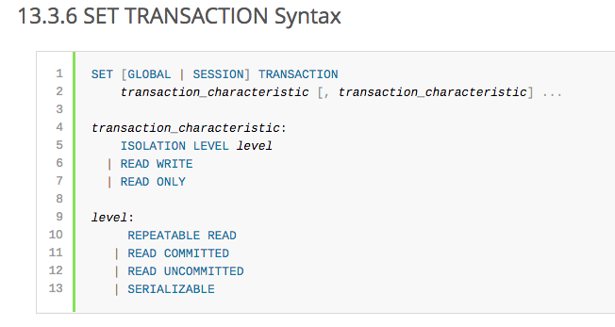
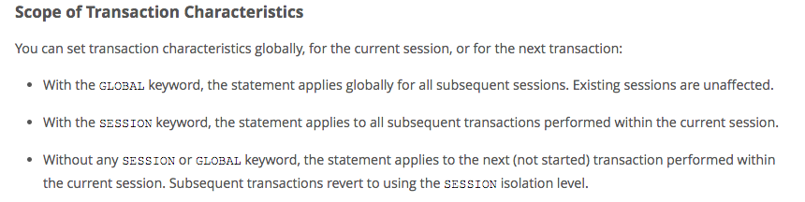
MySQL (Locking) Isolation
There are many application scenarios in which serializable is unnecessary.
It is “overkill.”
Unnecessary use of serializable may result in
lower concurrency and poor performance.

Slide 22
Isolation Levels (https://en.wikipedia.org/wiki/Isolation_(database_systems)
Not all transaction use cases require 2PL and serializable execution. Databases support a a set of levels.
Serializable
With a lock-based concurrency control DBMS implementation, serializability requires read and write locks (acquired on selected data) to be released at the end of the transaction. Also range-locks must be acquired when a SELECT query uses a ranged WHERE clause, especially to avoid the phantom reads phenomenon.
The execution of concurrent SQL-transactions at isolation level SERIALIZABLE is guaranteed to be serializable. A serializable execution is defined to be an execution of the operations of concurrently executing SQL-transactions that produces the same effect as some serial execution of those same SQL-transactions. A serial execution is one in which each SQL-transaction executes to completion before the next SQL-transaction begins.
Repeatable reads
In this isolation level, a lock-based concurrency control DBMS implementation keeps read and write locks (acquired on selected data) until the end of the transaction. However, range-locks are not managed, so phantom reads can occur.
Write skew is possible at this isolation level, a phenomenon where two writes are allowed to the same column(s) in a table by two different writers (who have previously read the columns they are updating), resulting in the column having data that is a mix of the two transactions.^{[3][4]}
Read committed
In this isolation level, a lock-based concurrency control DBMS implementation keeps write locks (acquired on selected data) until the end of the transaction, but read locks are released as soon as the SELECT operation is performed (so the non-repeatable reads phenomenon can occur in this isolation level). As in the previous level, range-locks are not managed.
Putting it in simpler words, read committed is an isolation level that guarantees that any data read is committed at the moment it is read. It simply restricts the reader from seeing any intermediate, uncommitted, 'dirty' read. It makes no promise whatsoever that if the transaction re-issues the read, it will find the same data; data is free to change after it is read.
Read uncommitted
This is the lowest isolation level. In this level, dirty reads are allowed, so one transaction may see not-yet-committed changes made by other transactions

Slide 23
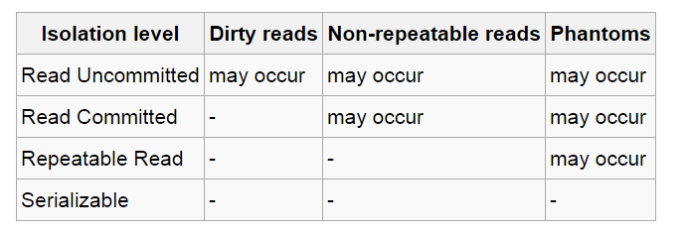
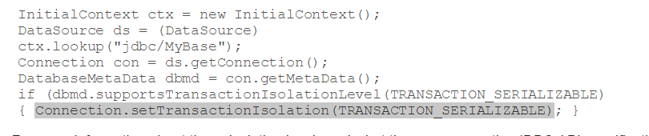
In Databases, Cursors Define Isolation
We have talked about ACID transactions
Atomic: A set of writes all occur or none occur.
Durable: The data “does not disappear,” e.g. write to disk.
Consistent: My applications move the database between consistent states, e.g. the transfer function works correctly.
Isolation
Determines what happens when two or more threads are manipulating the data at the same time.
And is defined relative to where cursors are and what they have touched.
Because the cursor movement determines what you are reading or have read.
But, … Cursors are client conversation state and cannot be used in REST.

Slide 24
CAP, BASE
Transactions Isolation Recovery

Slide 25
CAP Theorem
Consistency
Every read receives the most recent write or an error.
Availability
Every request receives a (non-error) response – without guarantee that it contains the most recent write.
Partition Tolerance
The system continues to operate despite an arbitrary number of messages being dropped (or delayed) by the network between nodes

Slide 26
Consistency Models
STRONG CONSISTENCY: Strong consistency is a consistency model where all subsequent accesses to a distributed system will always return the updated value after the update.
WEAK CONSISTENCY: It is a consistency model used in distributed computing where subsequent accesses might not always be returning the updated value. There might be inconsistent responses.
EVENTUAL CONSISTENCY: Eventual consistency is a special type of weak consistency method which informally guarantees that, if no new updates are made to a given data item, eventually all accesses to that item will return the last updated value.

Slide 27
BASE
Eventually-consistent services are often classified as providing BASE (Basically Available, Soft state, Eventual consistency) semantics, in contrast to traditional ACID (Atomicity, Consistency, Isolation, Durability) guarantees. Rough definitions of each term in BASE:
Basically Available: basic reading and writing operations are available as much as possible (using all nodes of a database cluster), but without any kind of consistency guarantees (the write may not persist after conflicts are reconciled, the read may not get the latest write)
Soft state: without consistency guarantees, after some amount of time, we only have some probability of knowing the state, since it may not yet have converged
Eventually consistent: If the system is functioning and we wait long enough after any given set of inputs, we will eventually be able to know what the state of the database is, and so any further reads will be consistent with our expectations

Slide 28
Eventual Consistency
Availability and scalability via
Multiple, replicated data stores.
Read goes to “any” replica.
PUT/POST/DELETE
Goes to any replica
Change propagate asynchronously
GET may not see the latest value if the update has not propagated to the replica.
There are several algorithms for conflict resolution
Detect and handle in application.
Clock/change vectors/version numbers
… …
get
put

Slide 29
ACID – BASE (Simplistic Comparison)
(Or other strategy)

Slide 30
Scalability, Availability
Transactions Isolation Recovery

Slide 31
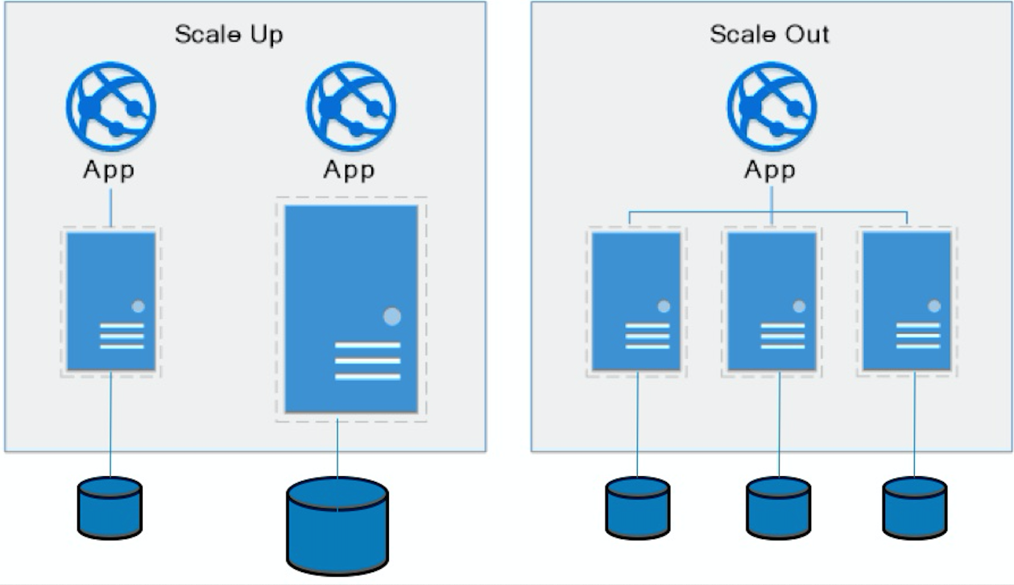
Approaches to Scalability
Scalability is the property of a system to handle a growing amount of work by adding resources to the system.
Replace system with a bigger machine, e.g. more memory, CPU, ... ...
Scale-up:
Less incremental.
More disruptive.
More expensive for extremely large systems.
Does not improve availability
Scale-out:
Incremental cost.
Data replication enables availability.
Does not work well for functions like JOIN, referential integrity, ... ...
Add another system.

Slide 32
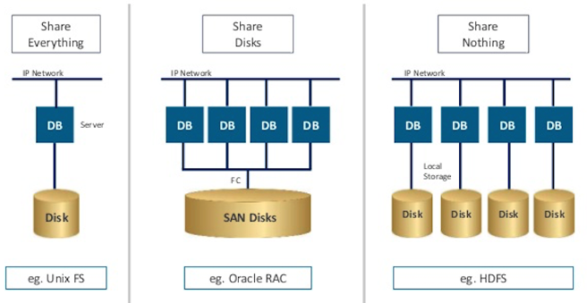
Disk Architecture for Scale-Out
Share disks:
Is basically scale-up for data/disks. You can use NAS, SAN and RAID.
Isolation/Integrity requires distributed locking to control access from multiple database servers.
Share nothing:
Is basically scale-out for disks.
Data is partitioned into shards based on a function f() applied to a key.
Can improve availability, at the code consistency, with data replication.
There is a router that sends requests to the proper shard based on the function.

Slide 33
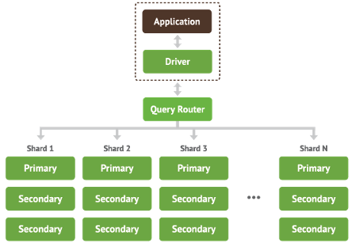
Shared Nothing, Scale-Out
MongoDB Sharding
DynamoDB Partitioning

Slide 34
Decision Support

Slide 35

Concepts
Schema Design Tradeoffs Data Warehouse, Data Lake, ETL

Slide 36
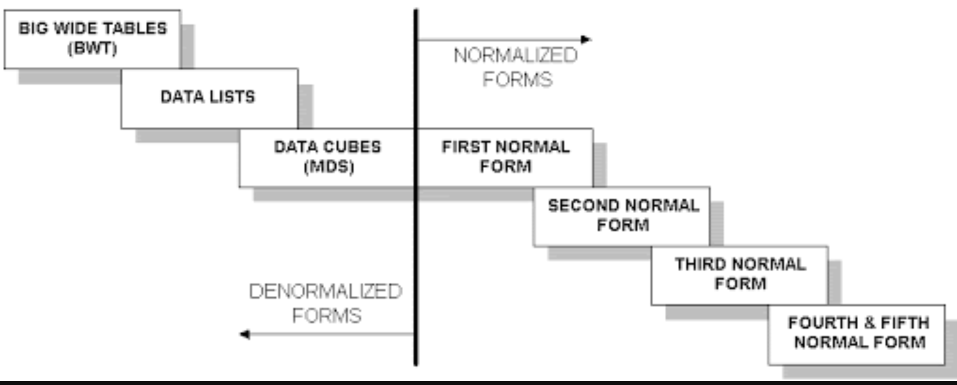
Wide Flat Tables
Good for Integrity
Good for Query
Improve query performance by precomputing and saving:
JOINs
Aggregation
Derived/computed columns
One of the primary strength of the relational model is maintaining “integrity” when applications create, update and delete data. This relies on:
The core capabilities of the relational model, e.g. constraints.
A well-design database (We will cover a formal definition – “normalization” in more detail later.
Data models that are well designed for integrity are very bad for read only analysis queries. We will build and analyze wide flat tables as part of the analysis tasks in HW3, HW4 as projects.

Slide 37
Chapter 20: Data Analysis
Decision Support Systems
Data Warehousing
Data Mining
Classification
Association Rules
Clustering

Slide 38
Decision Support Systems
Decision-support systems are used to make business decisions, often based on data collected by on-line transaction-processing systems.
Examples of business decisions:
What items to stock?
What insurance premium to change?
To whom to send advertisements?
Examples of data used for making decisions
Retail sales transaction details
Customer profiles (income, age, gender, etc.)

Slide 39
Decision-Support Systems: Overview
Data analysis tasks are simplified by specialized tools and SQL extensions
Example tasks
For each product category and each region, what were the total sales in the last quarter and how do they compare with the same quarter last year
As above, for each product category and each customer category
Statistical analysis packages (e.g., : S++) can be interfaced with databases
Statistical analysis is a large field, but not covered here
Data mining seeks to discover knowledge automatically in the form of statistical rules and patterns from large databases.
A data warehouse archives information gathered from multiple sources, and stores it under a unified schema, at a single site.
Important for large businesses that generate data from multiple divisions, possibly at multiple sites
Data may also be purchased externally

Slide 40
Data Warehousing
Data sources often store only current data, not historical data
Corporate decision making requires a unified view of all organizational data, including historical data
A data warehouse is a repository (archive) of information gathered from multiple sources, stored under a unified schema, at a single site
Greatly simplifies querying, permits study of historical trends
Shifts decision support query load away from transaction processing systems

Slide 41
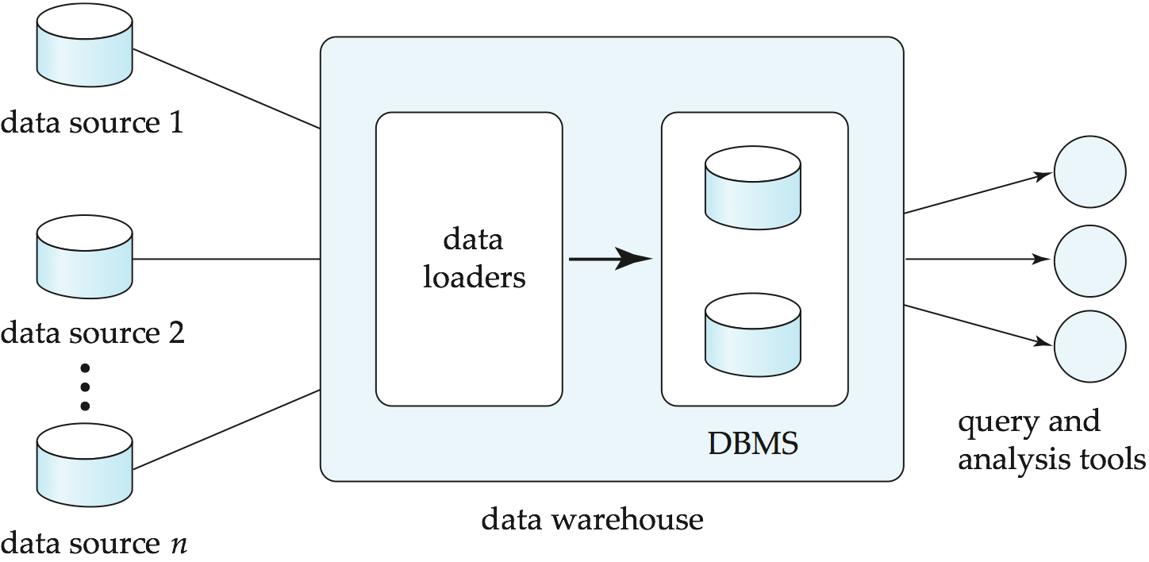
Data Warehousing

Slide 42
Data Warehouse vs Data Lake
https://www.grazitti.com/blog/data-lake-vs-data-warehouse-which-one-should-you-go-for/

Slide 43
Simplistic: Data Warehouse vs Data Lake
https://panoply.io/data-warehouse-guide/data-warehouse-vs-data-lake/

Slide 44
Design Issues
When and how to gather data
Source driven architecture: data sources transmit new information to warehouse, either continuously or periodically (e.g., at night)
Destination driven architecture: warehouse periodically requests new information from data sources
Keeping warehouse exactly synchronized with data sources (e.g., using two-phase commit) is too expensive
Usually OK to have slightly out-of-date data at warehouse
Data/updates are periodically downloaded form online transaction processing (OLTP) systems.
What schema to use
Schema integration

Slide 45
More Warehouse Design Issues
Data cleansing
E.g., correct mistakes in addresses (misspellings, zip code errors)
Merge address lists from different sources and purge duplicates
How to propagate updates
Warehouse schema may be a (materialized) view of schema from data sources
What data to summarize
Raw data may be too large to store on-line
Aggregate values (totals/subtotals) often suffice
Queries on raw data can often be transformed by query optimizer to use aggregate values

Slide 46
Warehouse Schemas
Dimension values are usually encoded using small integers and mapped to full values via dimension tables
Resultant schema is called a star schema
More complicated schema structures
Snowflake schema: multiple levels of dimension tables
Constellation: multiple fact tables

Slide 47
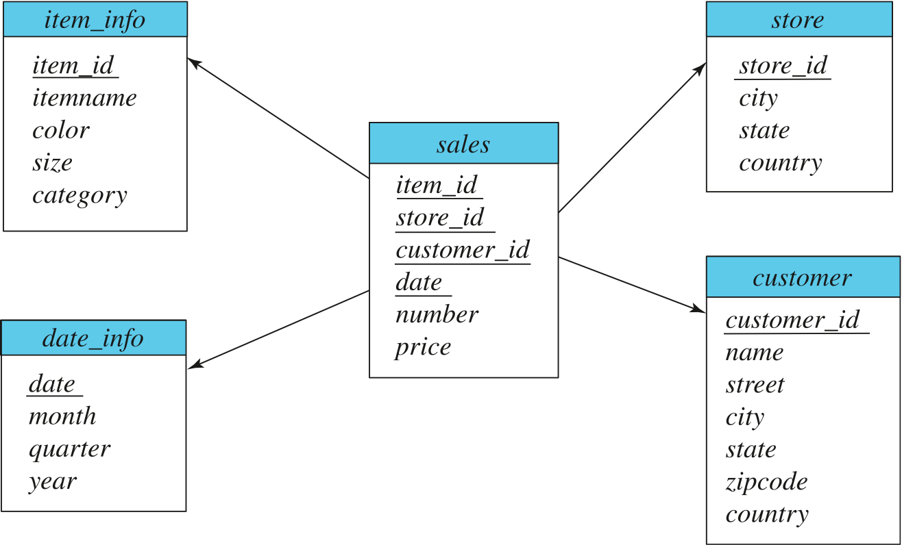
Data Warehouse Schema

Slide 48
Overview (Cont.)
Common steps in data analytics
Gather data from multiple sources into one location
Data warehouses also integrated data into common schema
Data often needs to be extracted from source formats, transformed to common schema, and loaded into the data warehouse
Can be done as ETL (extract-transform-load), or ELT (extract-load-transform)
Generate aggregates and reports summarizing data
Dashboards showing graphical charts/reports
Online analytical processing (OLAP) systems allow interactive querying
Statistical analysis using tools such as R/SAS/SPSS
Including extensions for parallel processing of big data
Build predictive models and use the models for decision making

Slide 49
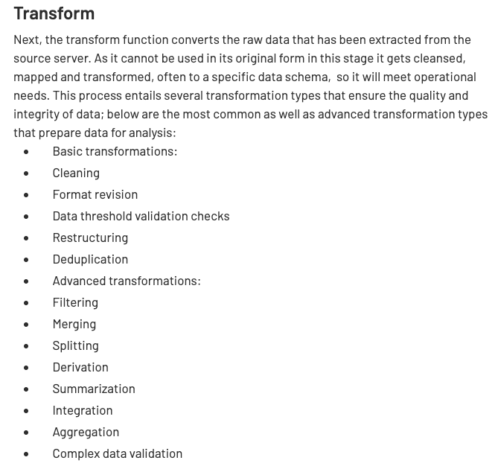
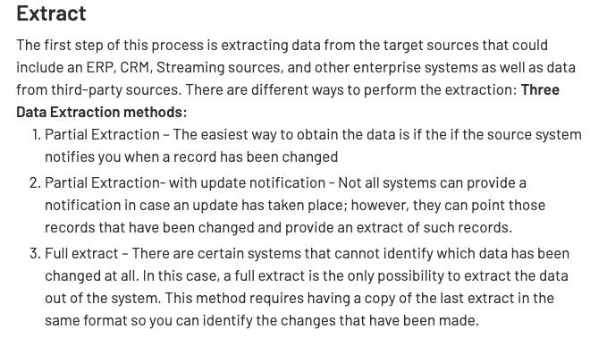
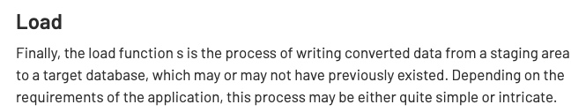
ETL Concepts
https://databricks.com/glossary/extract-transform-load

Slide 50
MapReduce, Spark (and ETL)
50 | Introduction to Databases (F20): Lecture 12 – Big Data and Analytics

Slide 51
MapReduce
MapReduce is a data flow program with relatively simple operators on the data set.
op1
op2
op3
With each operator implemented in parallel on multiple nodes for performance.
What if we want more complex “operators?”

Slide 52
Algebraic Operations
Current generation execution engines
natively support algebraic operations such as joins, aggregation, etc. natively.
Allow users to create their own algebraic operators
Support trees of algebraic operators that can be executed on multiple nodes in parallel
E.g. Apache Tez, Spark
Tex provides low level API; Hive on Tez compiles SQL to Tez
Spark provides more user-friendly API
In the relational model,
The are relations.
A fixed set of operators that produce relations from relations (closed).
Are declarative languages and compute the execution graph/plan.
The Spark/... ... engines:
Enable programmers to develop and add new operators.
Operators convert reliable distributed datasets/data frames to new RDDs/data frames.
Data engineer explicitly defines the execution graph (data flow).

Slide 53
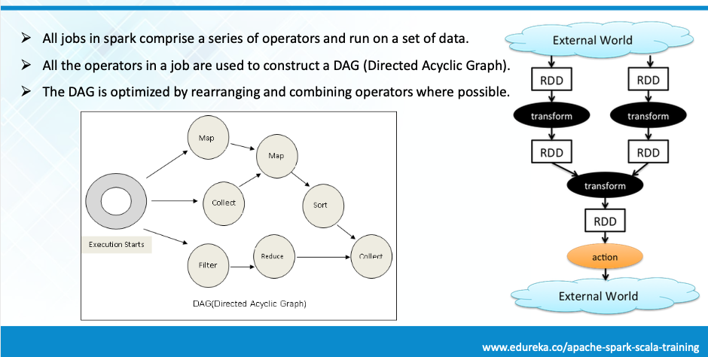
Spark

Slide 54
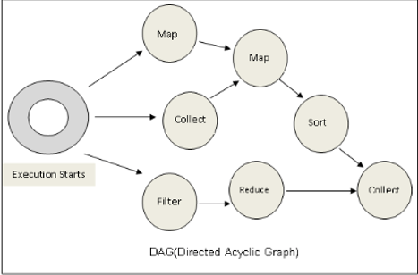
Spark vs SQL
Conceptually similar to query evaluation graph, but ...
You explicitly define the graph.
You can develop your own operators.
You can define levels of parallelism that the infrastructure manages.
SQL is declarative, and the query engine transparently produces the execution plan.

Slide 55
Algebraic Operations in Spark
Resilient Distributed Dataset (RDD) abstraction
Collection of records that can be stored across multiple machines
RDDs can be created by applying algebraic operations on other RDDs
RDDs can be lazily computed when needed
Spark programs can be written in Java/Scala/R
Our examples are in Java
Spark makes use of Java 8 Lambda expressions; the code
s - > Arrays.asList(s.split(" ")).iterator()
defines unnamed function that takes argument s and executes the expression Arrays.asList(s.split(" ")).iterator() on the argument
Lambda functions are particularly convenient as arguments to map, reduce and other functions

Slide 56
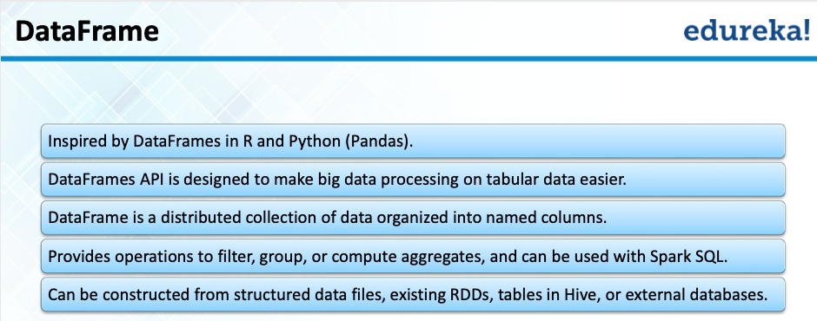
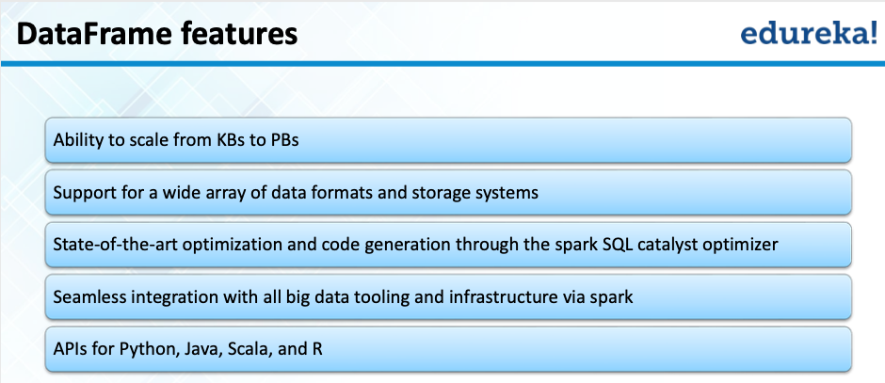
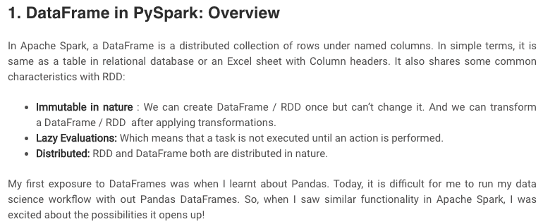
Spark/PySpark
https://www.analyticsvidhya.com/blog/2016/10/spark-dataframe-and-operations/

Slide 57
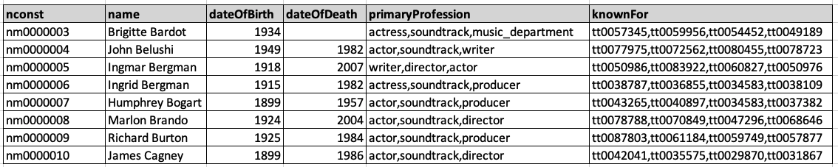
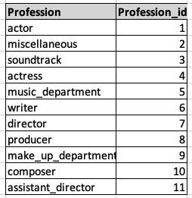
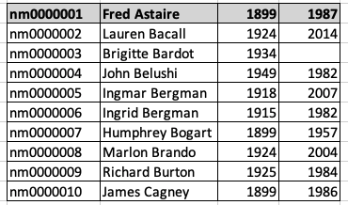
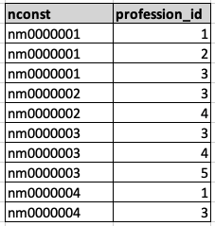
Conceptual Example
Remember that really unpleasant set of queries and stored procedure we had to write for the midterm? You had to convert from ... ...
To

Slide 58
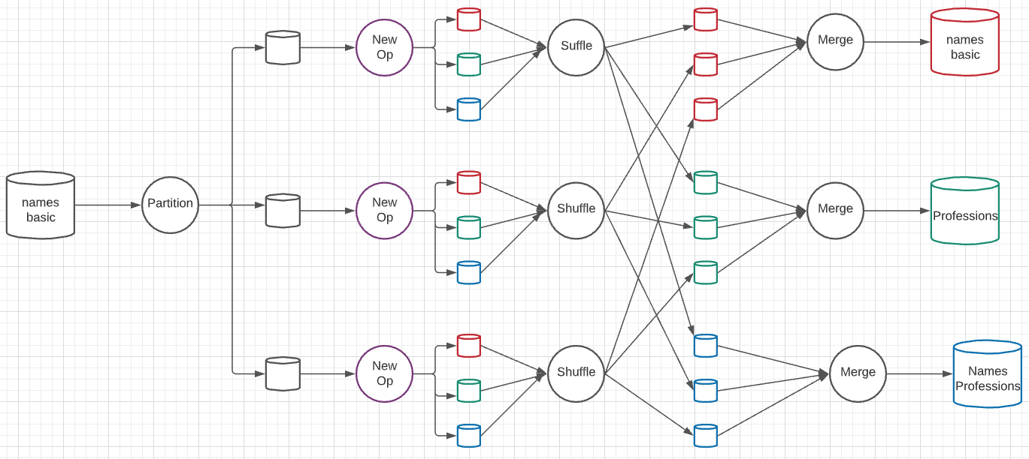
A New Algebraic Operator
Parallelism level is 3 simultaneous services at each stage.
Input is a dataset and column ID
Output is three datasets: dataset with column removed, table of distinct column values, associative entity.

Slide 59
A New Algebraic Operator
Show example from notebook.
Input is a dataset and column ID
Output is three datasets: dataset with column removed, table of distinct column values, associative entity.

Slide 60
OLAP
60 | Introduction to Databases (F20): Lecture 12 – Big Data and Analytics

Slide 61
Data Analysis and OLAP
Online Analytical Processing (OLAP)
Interactive analysis of data, allowing data to be summarized and viewed in different ways in an online fashion (with negligible delay)
We use the following relation to illustrate OLAP concepts
sales (item_name, color, clothes_size, quantity)
This is a simplified version of the sales fact table joined with the dimension tables, and many attributes removed (and some renamed)

Slide 62
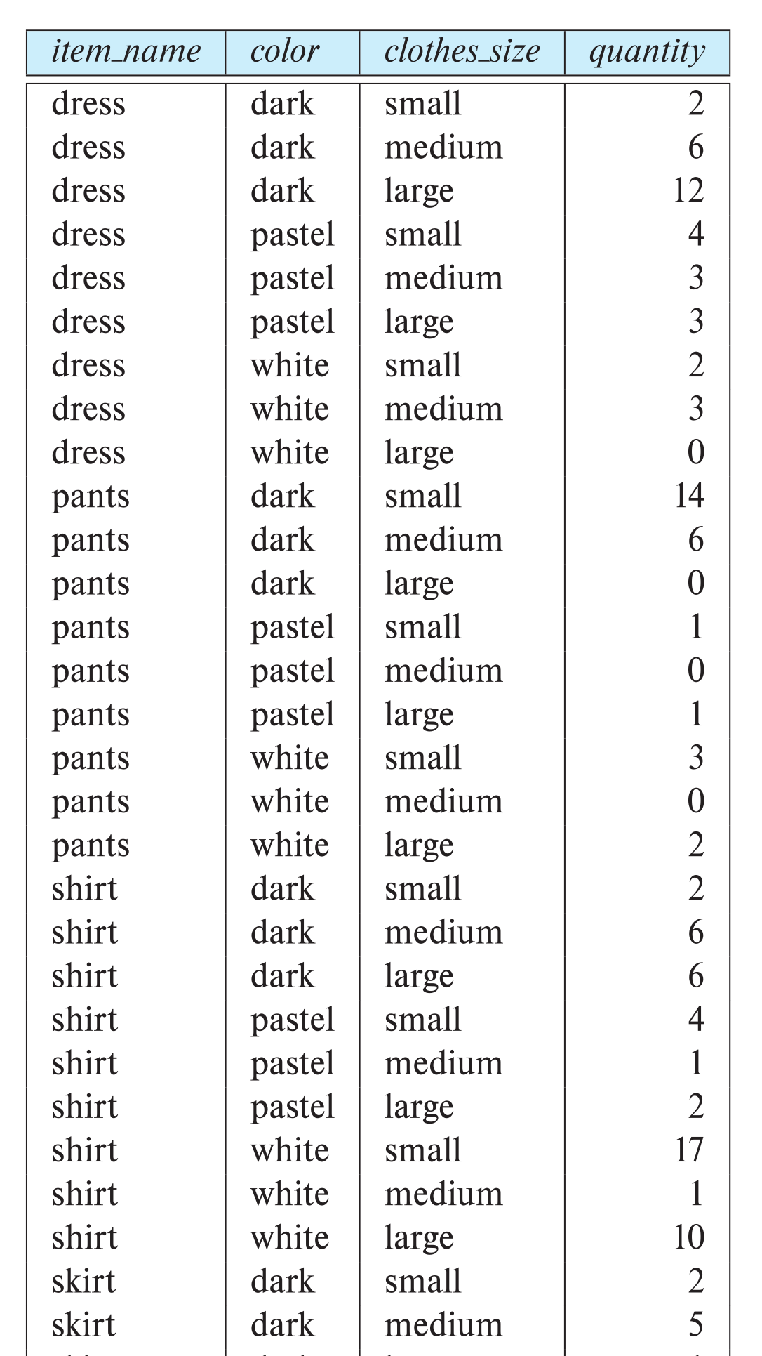
Example sales relation
...
...
...
...
...
...
...
...

Slide 63
Cross Tabulation of sales by item_name and color
The table above is an example of a cross-tabulation (cross-tab), also referred to as a pivot-table.
Values for one of the dimension attributes form the row headers
Values for another dimension attribute form the column headers
Other dimension attributes are listed on top
Values in individual cells are (aggregates of) the values of the dimension attributes that specify the cell.

Slide 64
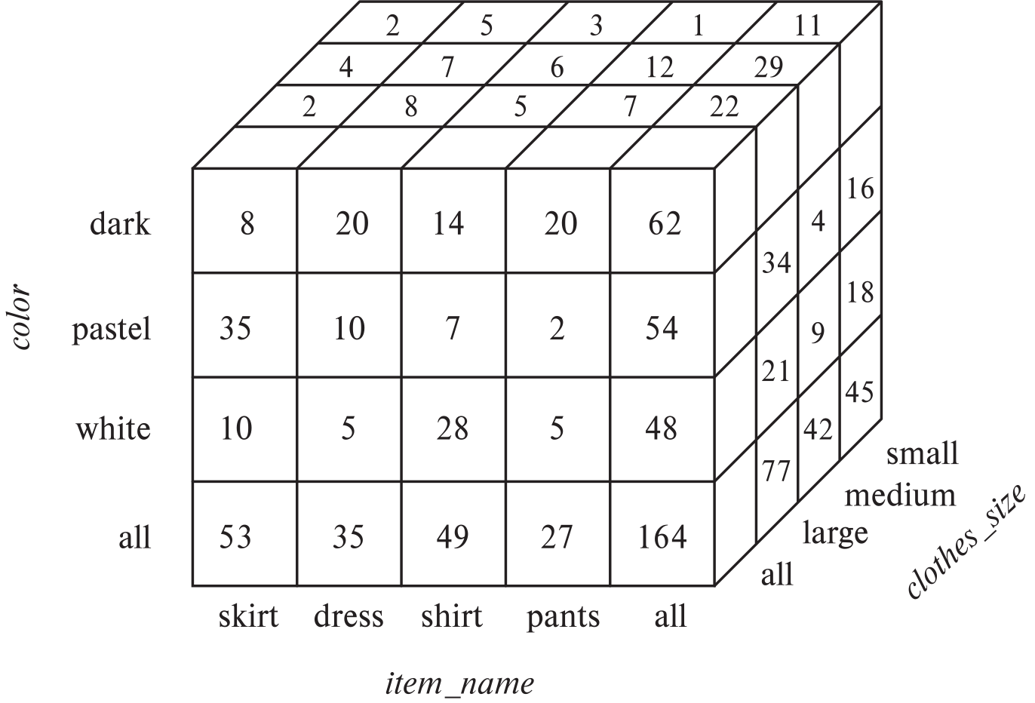
Data Cube
A data cube is a multidimensional generalization of a cross-tab
Can have n dimensions; we show 3 below
Cross-tabs can be used as views on a data cube

Slide 65
Online Analytical Processing Operations
Pivoting: changing the dimensions used in a cross-tab
E.g., moving colors to column names
Slicing: creating a cross-tab for fixed values only
E.g., fixing color to white and size to small
Sometimes called dicing, particularly when values for multiple dimensions are fixed.
Rollup: moving from finer-granularity data to a coarser granularity
E.g., aggregating away an attribute
E.g., moving from aggregates by day to aggregates by month or year
Drill down: The opposite operation - that of moving from coarser-granularity data to finer-granularity data

Slide 66
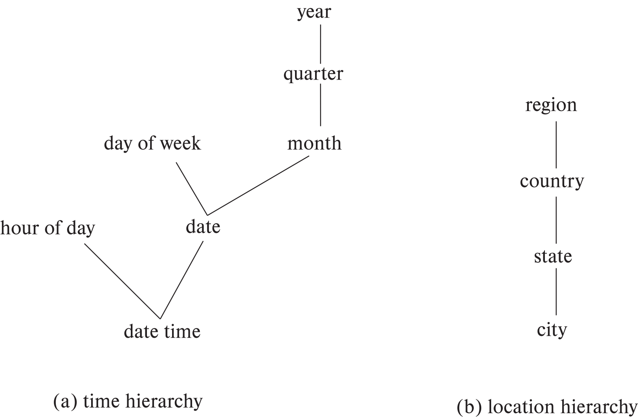
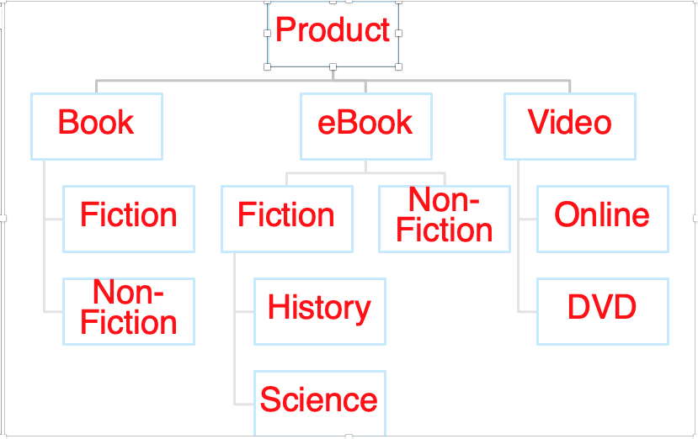
Hierarchies on Dimensions
Hierarchy on dimension attributes: lets dimensions be viewed at different levels of detail
E.g., the dimension datetime can be used to aggregate by hour of day, date, day of week, month, quarter or year
Another dimension could be ... Product category.

Slide 67
Another Dimension Example – Product Categories
Product
Book
eBook
Video
Fiction
Non-Fiction
Non-
Fiction
Fiction
Online
DVD
History
Science

Slide 68
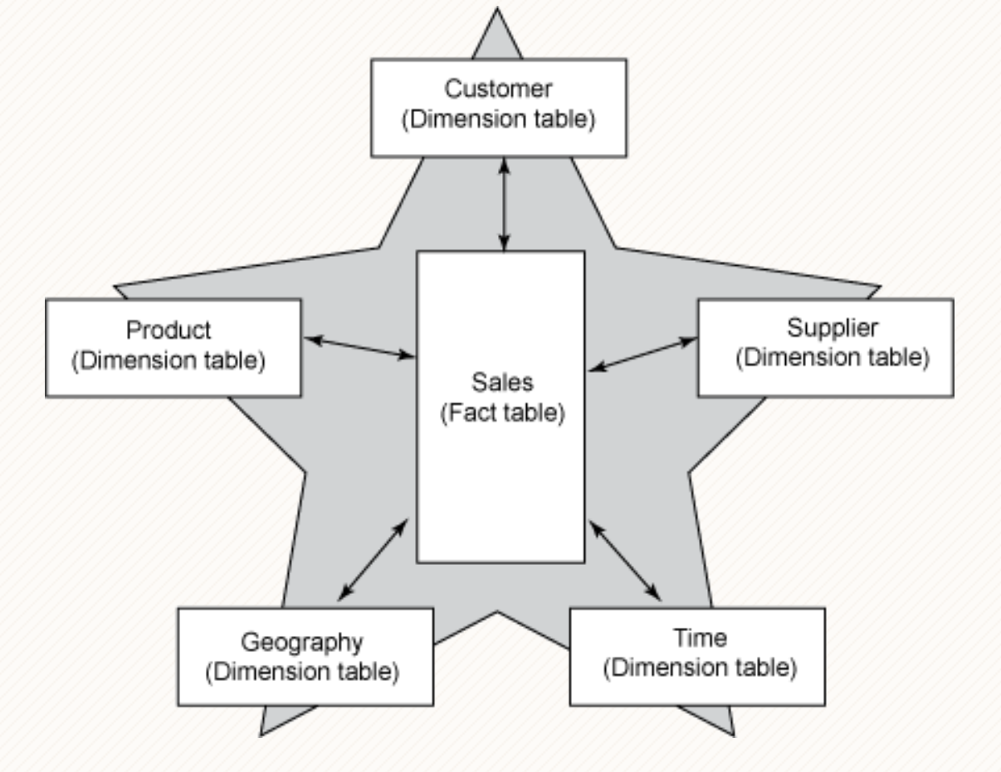
Facts and Dimensions

Slide 69
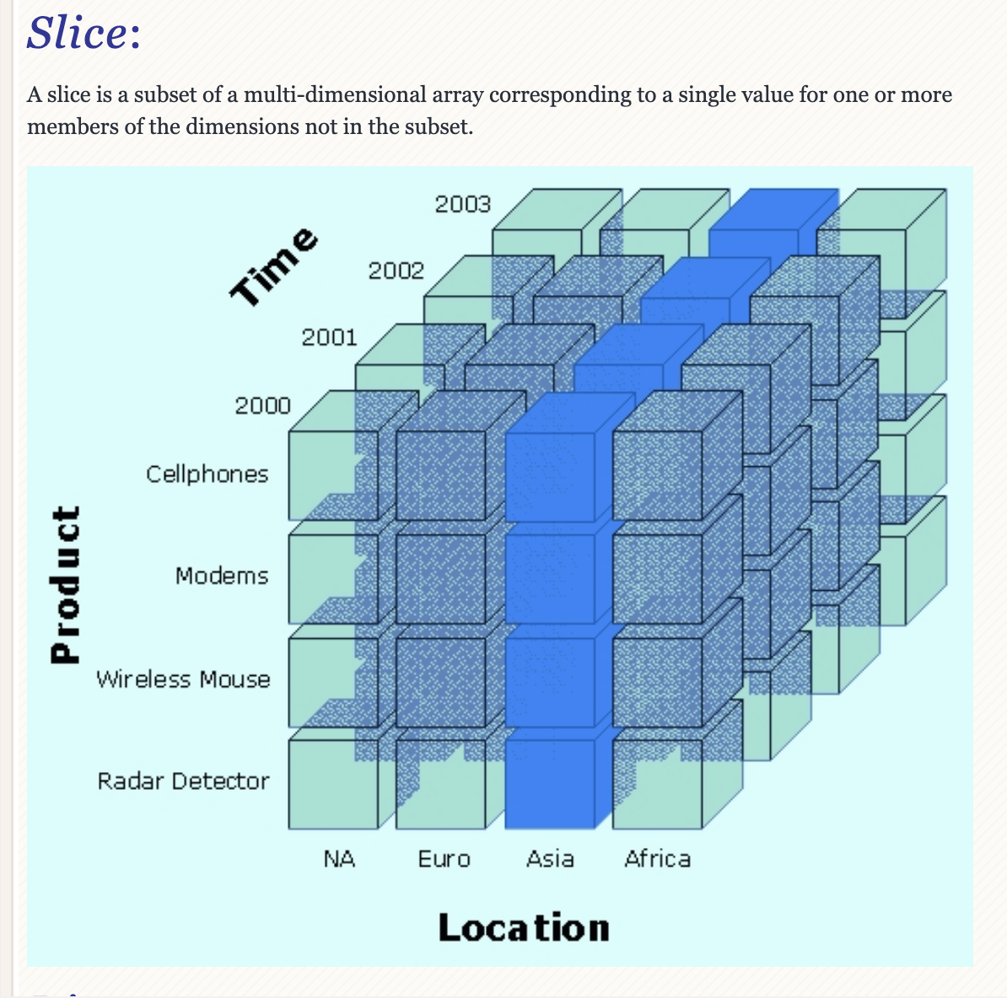
Slice

Slide 70
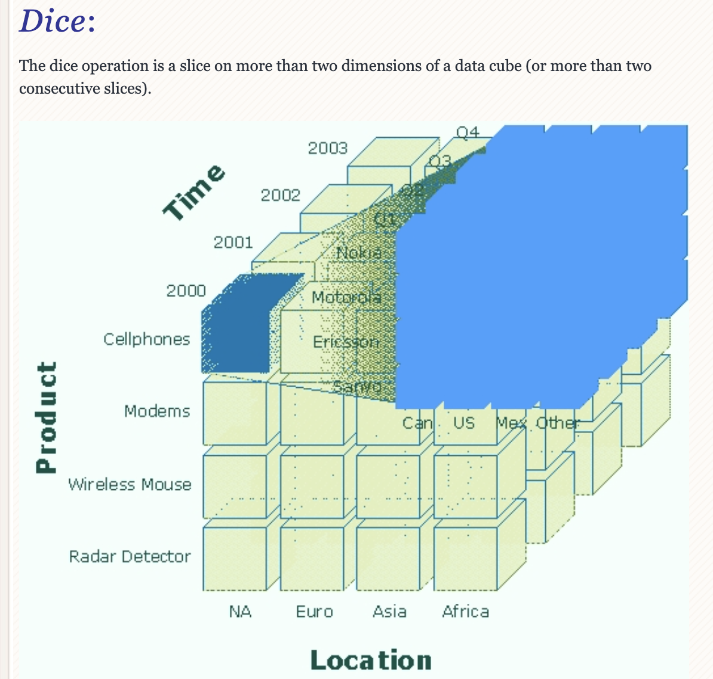
Dice

Slide 71
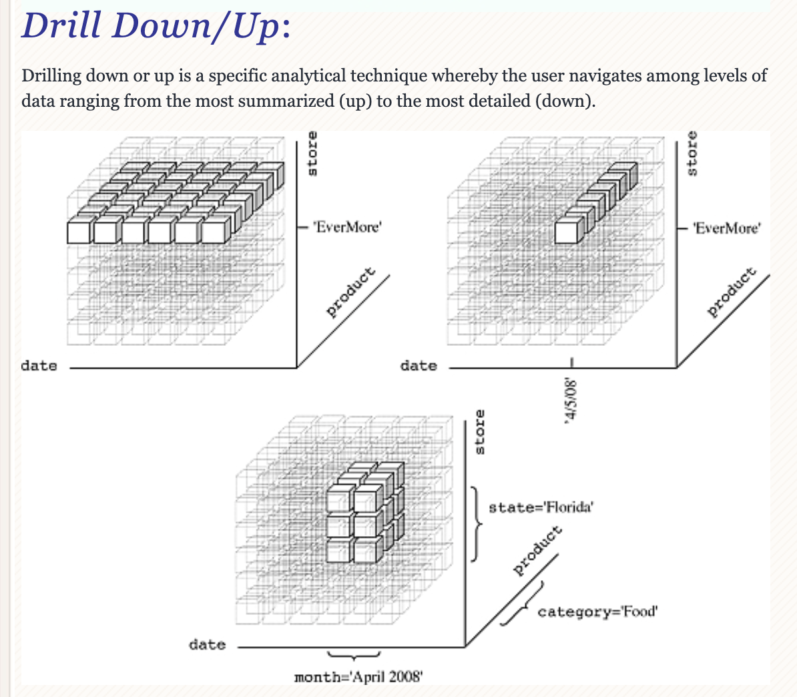
Drilling

Slide 72
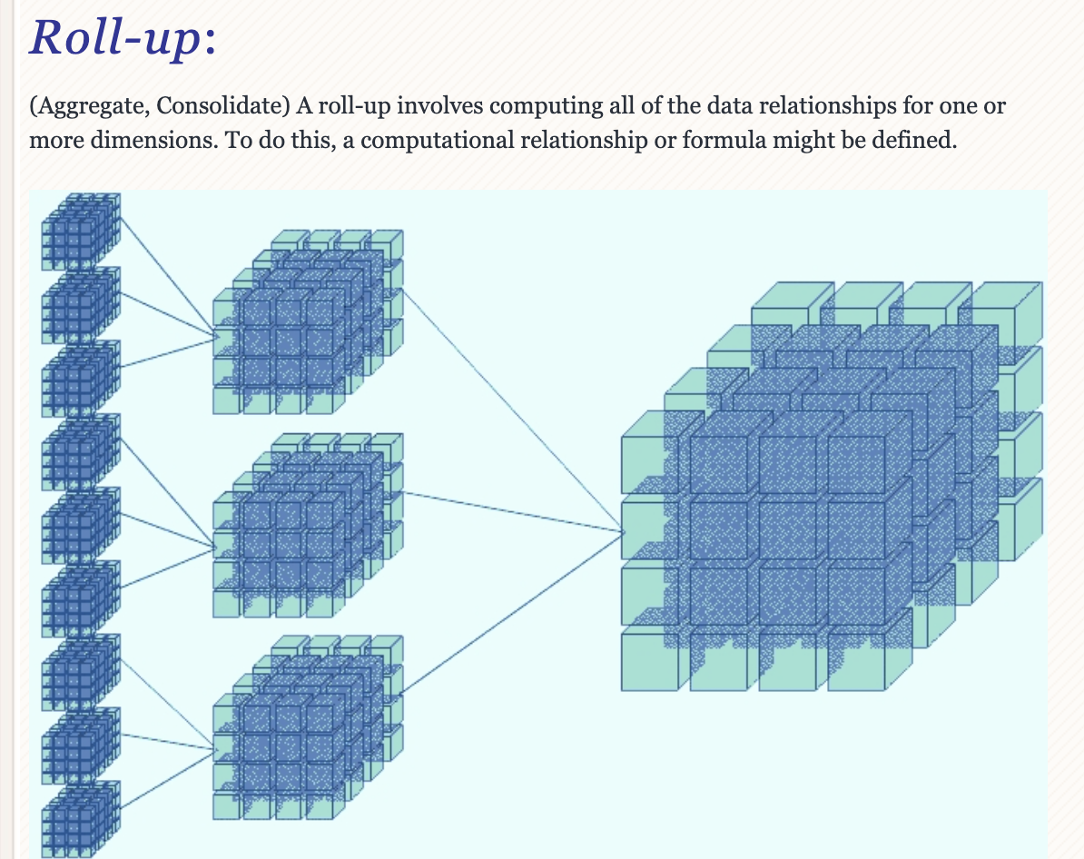
Roll-up

Slide 73
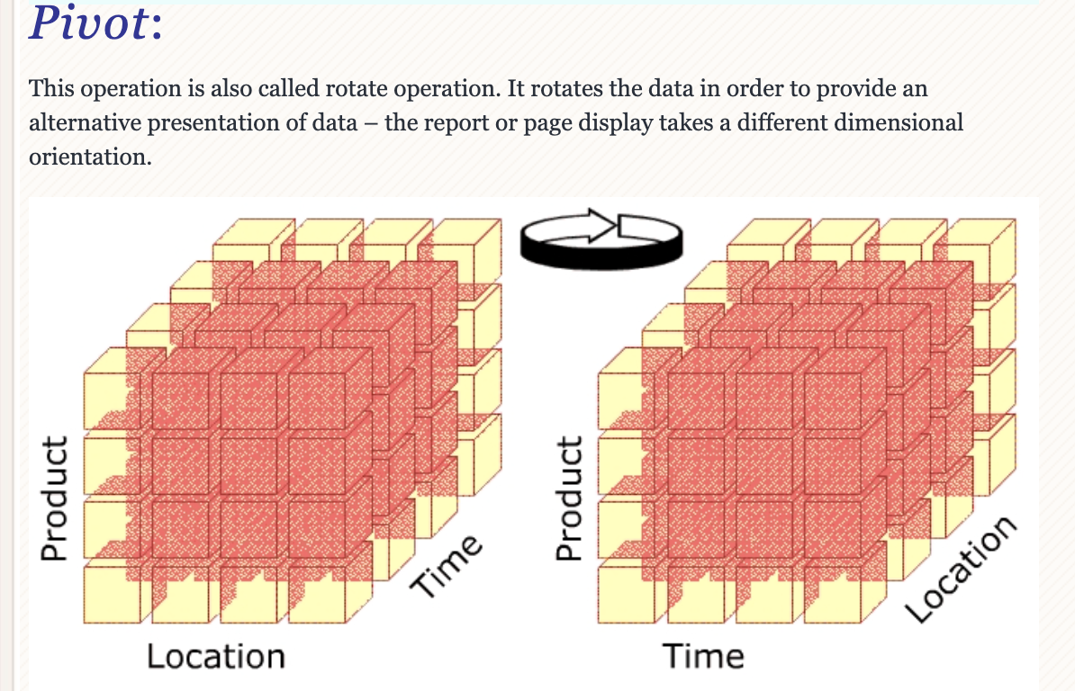
Pivot

Slide 74
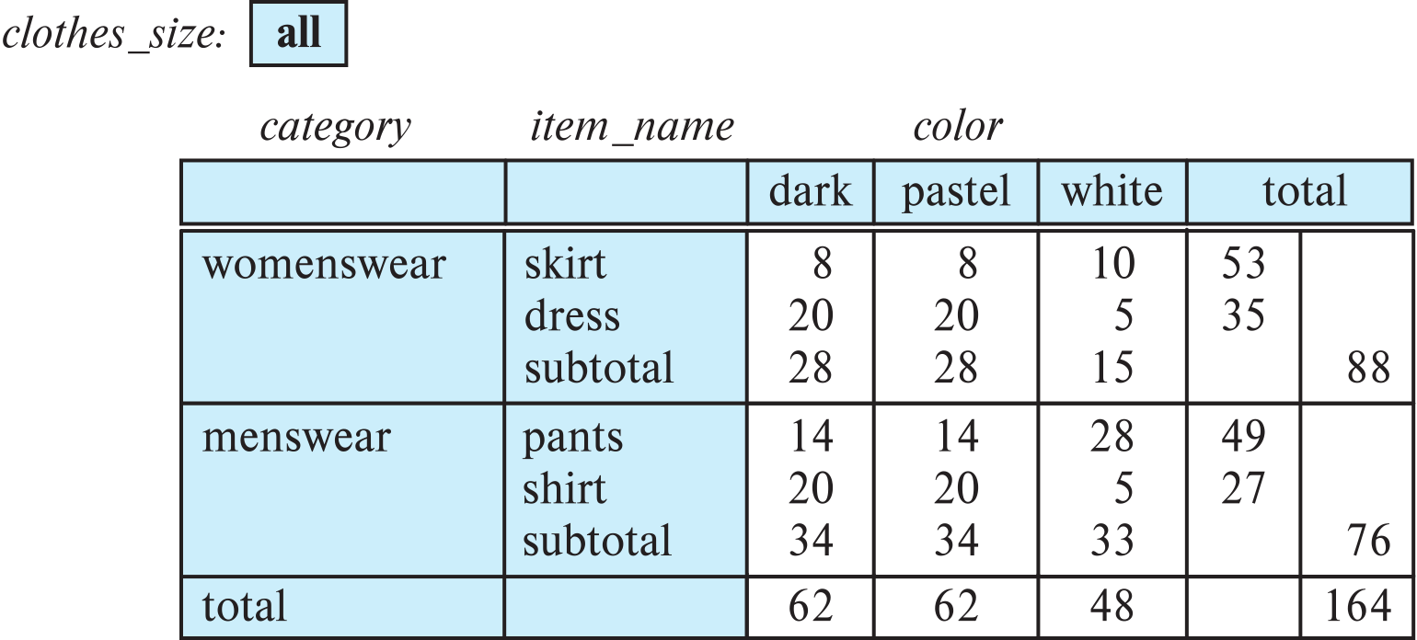
Cross Tabulation With Hierarchy
Cross-tabs can be easily extended to deal with hierarchies
Can drill down or roll up on a hierarchy
E.g. hierarchy: item_name → category

Slide 75
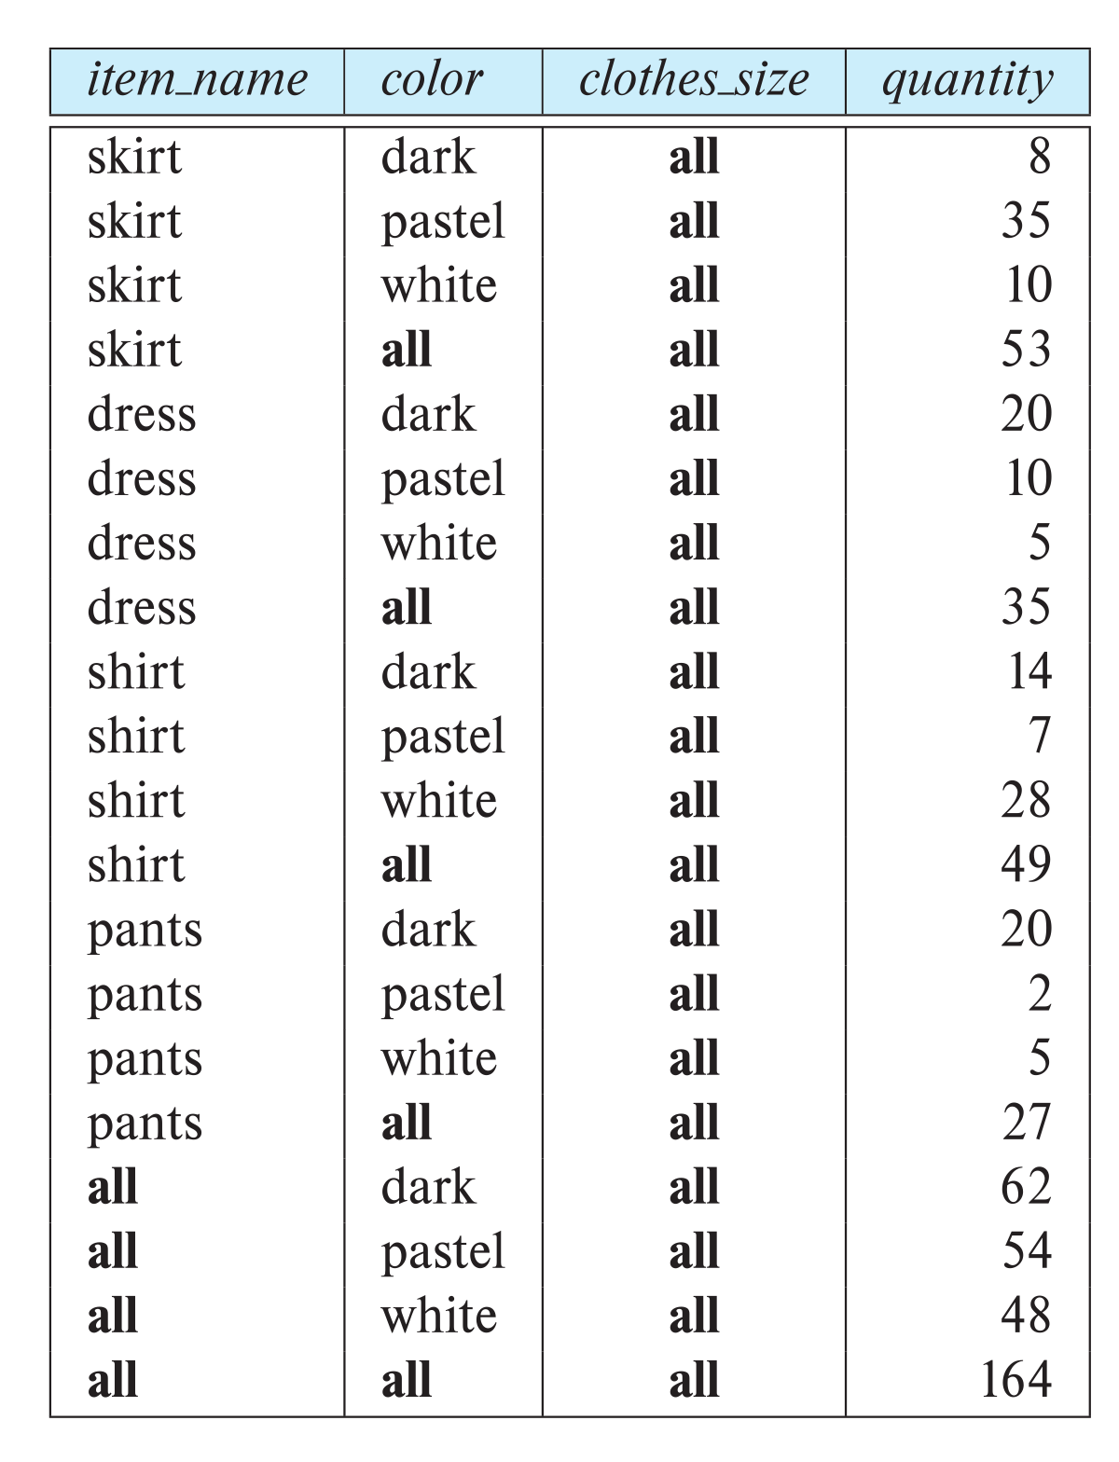
Relational Representation of Cross-tabs
Cross-tabs can be represented as relations
We use the value all to represent aggregates.
The SQL standard actually uses null values in place of all
Works with any data type
But can cause confusion with regular null values.

Slide 76
Data Mining
76 | Introduction to Databases (F20): Lecture 12 – Big Data and Analytics

Slide 77
Data Mining
Data mining is the process of semi-automatically analyzing large databases to find useful patterns
Similar goals to machine learning, but on very large volumes of data
Part of the larger area of knowledge discovery in databases (KDD)
Some types of knowledge can be represented as rules
More generally, knowledge is discovered by applying machine learning techniques on past instances of data, to form a model
Model is then used to make predictions for new instances

Slide 78
Types of Data Mining Tasks
Prediction based on past history
Predict if a credit card applicant poses a good credit risk, based on some attributes (income, job type, age, ..) and past history
Predict if a pattern of phone calling card usage is likely to be fraudulent
Some examples of prediction mechanisms:
Classification
Items (with associated attributes) belong to one of several classes
Training instances have attribute values and classes provided
Given a new item whose class is unknown, predict to which class it belongs based on its attribute values
Regression formulae
Given a set of mappings for an unknown function, predict the function result for a new parameter value

Slide 79
Data Mining (Cont.)
Descriptive Patterns
Associations
Find books that are often bought by “similar” customers. If a new such customer buys one such book, suggest the others too.
Associations may be used as a first step in detecting causation
E.g., association between exposure to chemical X and cancer,
Clusters
E.g., typhoid cases were clustered in an area surrounding a contaminated well
Detection of clusters remains important in detecting epidemics

Slide 80
Classification Rules
Classification rules help assign new objects to classes.
E.g., given a new automobile insurance applicant, should he or she be classified as low risk, medium risk or high risk?
Classification rules for above example could use a variety of data, such as educational level, salary, age, etc.
∀ person P, P.degree = masters and P.income > 75,000
⇒ P.credit = excellent
∀ person P, P.degree = bachelors and (P.income ≥ 25,000 and P.income ≤ 75,000) ⇒ P.credit = good
Rules are not necessarily exact: there may be some misclassifications
Classification rules can be shown compactly as a decision tree.

Slide 81
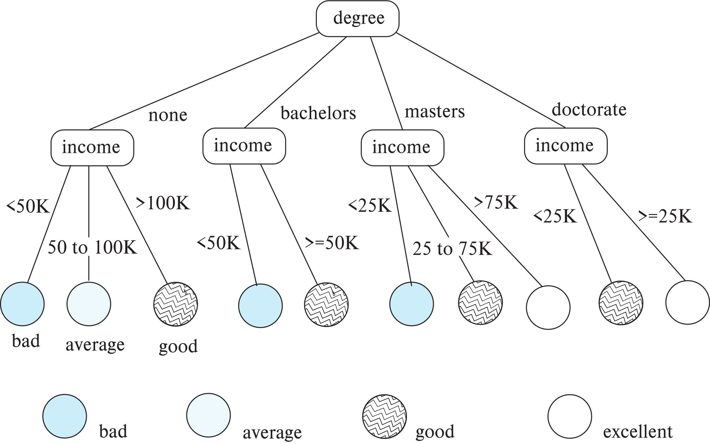
Decision Tree Classifiers

Slide 82
Decision Trees
Each internal node of the tree partitions the data into groups based on a partitioning attribute, and a partitioning condition for the node
Leaf node:
all (or most) of the items at the node belong to the same class, or
all attributes have been considered, and no further partitioning is possible.
Traverse tree from top to make a prediction
Number of techniques for constructing decision tree classifiers
We omit details

Slide 83
Bayesian Classifiers
Bayesian classifiers use Bayes theorem, which says
p (c_{j} | d ) = p (d | c_{j} ) p(c_{j} )
p (d) where p (c_{j} | d) = probability of instance d being in class c_{j},
p (d | c_{j} ) = probability of generating instance d given class c_{j},
p (c_{j} ) = probability of occurrence of class c_{j}, and
p (d) = probability of instance d occuring

Slide 84
Naïve Bayesian Classifiers
Bayesian classifiers require
computation of p (d | c_{j} )
precomputation of p (c_{j} )
p (d) can be ignored since it is the same for all classes
To simplify the task, naïve Bayesian classifiers assume attributes have independent distributions, and thereby estimate
p (d | c_{j}) = p (d₁ | c_{j} ) * p (d₂ | c_{j} ) * ….* (p (d_{n} | c_{j} )
Each of the p (d_{i} | c_{j} ) can be estimated from a histogram on d_{i} values for each class c_{j}
the histogram is computed from the training instances
Histograms on multiple attributes are more expensive to compute and store

Slide 85
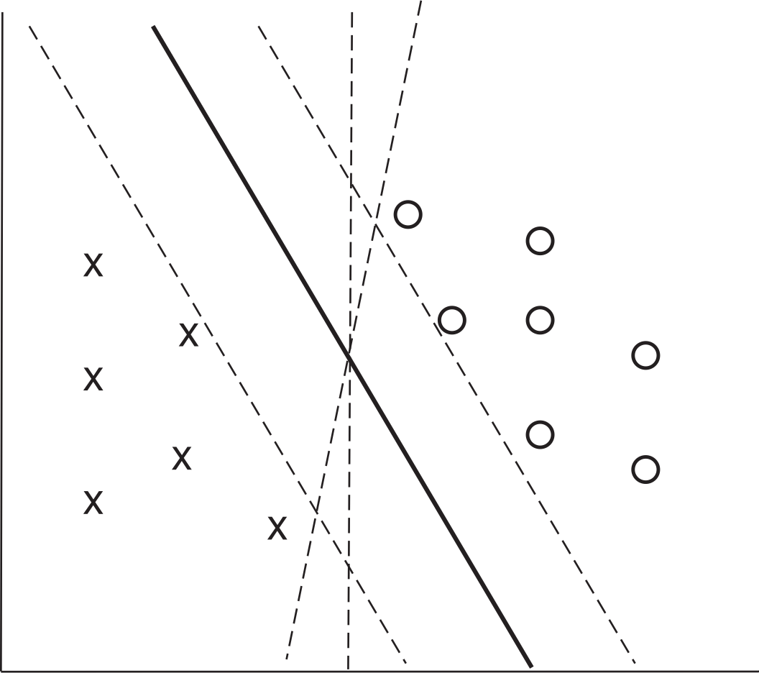
Support Vector Machine Classifiers
Simple 2-dimensional example:
Points are in two classes
Find a line (maximum margin line) s.t. line divides two classes, and distance from nearest point in either class is maximum

Slide 86
Support Vector Machine
In n-dimensions points are divided by a plane, instead of a line
SVMs can be used separators that are curve, not necessarily linear, by transforming points before classification
Transformation functions may be non-linear and are called kernel functions
Separator is a plane in the transformed space, but maps to curve in original space
There may not be an exact planar separator for a given set of points
Choose plane that best separates points
N-ary classification can be done by N binary classifications
In class i vs. not in class i.

Slide 87
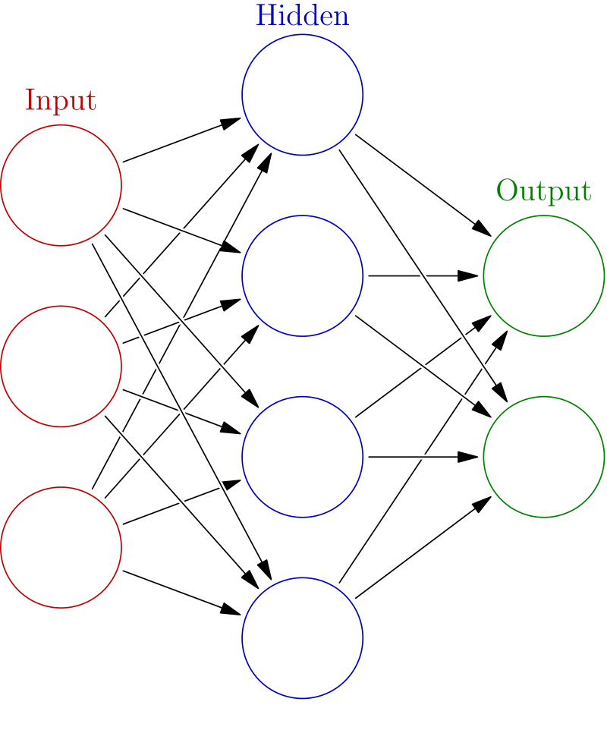
Neural Network Classifiers
Neural network has multiple layers
Each layer acts as input to next later
First layer has input nodes, which are assigned values from input attributes
Each node combines values of its inputs using some weight function to compute its value
Weights are associated with edges
For classification, each output value indicates likelihood of the input instance belonging to that class
Pick class with maximum likelihood
Weights of edges are key to classification
Edge weights are learnt during training phase

Slide 88

Neural Network Classifiers
Value of a node may be linear combination of inputs, or may be a non-linear function
E.g., sigmoid function
Backpropagation algorithm works as follows
Weights are set randomly initially
Training instances are processed one at a time
Output is computed using current weights
If classification is wrong, weights are tweaked to get a higher score for the correct class

Slide 89
Neural Networks (Cont.)
Deep neural networks have a large number of layers with large number of nodes in each layer
Deep learning refers to training of deep neural network on very large numbers of training instances
Each layer may be connected to previous layers in different ways
Convolutional networks used for image processing
More complex architectures used for text processing, and machine translation, speech recognition, etc.
Neural networks are a large area in themselves
Further details beyond scope of this chapter

Slide 90
Regression
Regression deals with the prediction of a value, rather than a class.
Given values for a set of variables, X₁, X₂, …, X_{n}, we wish to predict the value of a variable Y.
One way is to infer coefficients a₀, a₁, a₁, …, a_{n} such that Y = a₀ + a₁ * X₁ + a₂ * X₂ + … + a_{n} * X_{n}
Finding such a linear polynomial is called linear regression.
In general, the process of finding a curve that fits the data is also called curve fitting.
The fit may only be approximate
because of noise in the data, or
because the relationship is not exactly a polynomial
Regression aims to find coefficients that give the best possible fit.

Slide 91
Association Rules
Retail shops are often interested in associations between different items that people buy.
Someone who buys bread is quite likely also to buy milk
A person who bought the book Database System Concepts is quite likely also to buy the book Operating System Concepts.
Associations information can be used in several ways.
E.g. when a customer buys a particular book, an online shop may suggest associated books.
Association rules:
bread ⇒ milk DB-Concepts, OS-Concepts ⇒ Networks
Left hand side: antecedent, right hand side: consequent
An association rule must have an associated population; the population consists of a set of instances
E.g. each transaction (sale) at a shop is an instance, and the set of all transactions is the population

Slide 92
Association Rules (Cont.)
Rules have an associated support, as well as an associated confidence.
Support is a measure of what fraction of the population satisfies both the antecedent and the consequent of the rule.
E.g., suppose only 0.001 percent of all purchases include milk and screwdrivers. The support for the rule is milk ⇒ screwdrivers is low.
Confidence is a measure of how often the consequent is true when the antecedent is true.
E.g., the rule bread ⇒ milk has a confidence of 80 percent if 80 percent of the purchases that include bread also include milk.
We omit further details, such as how to efficiently infer association rules

Slide 93
Clustering
Clustering: Intuitively, finding clusters of points in the given data such that similar points lie in the same cluster
Can be formalized using distance metrics in several ways
Group points into k sets (for a given k) such that the average distance of points from the centroid of their assigned group is minimized
Centroid: point defined by taking average of coordinates in each dimension.
Another metric: minimize average distance between every pair of points in a cluster
Hierarchical clustering: example from biological classification
(the word classification here does not mean a prediction mechanism)
chordata mammalia reptilia
leopards humans snakes crocodiles

Slide 94
Clustering and Collaborative Filtering
Goal: predict what movies/books/… a person may be interested in, on the basis of
Past preferences of the person
Preferences of other people
One approach based on repeated clustering
Cluster people based on their preferences for movies
Then cluster movies on the basis of being liked by the same clusters of people
Again cluster people based on their preferences for (the newly created clusters of) movies
Repeat above till equilibrium
Given new user
Find most similar cluster of existing users and
Predict movies in movie clusters popular with that user cluster
Above problem is an instance of collaborative filtering

Slide 95
Other Types of Mining
Text mining: application of data mining to textual documents
Sentiment analysis
E.g., learn to predict if a user review is positive or negative about a product
Information extraction
Create structured information from unstructured textual description or semi-structured data such as tabular displays
Entity recognition and disambiguation
E.g., given text with name “Michael Jordan” does the name refer to the famous basketball player or the famous ML expert
Knowledge graph (see Section 8.4)
Can be constructed by information extraction from different sources, such as Wikipedia

Slide 96
Worked Example Classic Models

Slide 97
Denormalization Example
97 | Introduction to Databases (S19): Lecture 13: Normalization, Data Analysis

Slide 98
Classic Models (Cars) Database
http://www.mysqltutorial.org/mysql-sample-database.aspx
The classic models (cars) database we have seen has the following tables:
Customers: stores customer’s data.
Products: stores a list of scale model cars.
ProductLines: stores a list of product line categories.
Orders: stores sales orders placed by customers.
OrderDetails: stores sales order line items for each sales order.
Payments: stores payments made by customers based on their accounts.
Employees: stores all employee information as well as the organization structure such as who reports to whom.
Offices: stores sales office data.

Slide 99
Normalized Schema
The normalization helps prevent update errors:
I cannot create an order without a valid customer no.
An order cannot have an invalid product ID.
etc.
But some interesting data insight questions require complicated joins, “Please show me the total number of instances of products from vendor XXX that employees in office YYY have sold.”

Slide 100
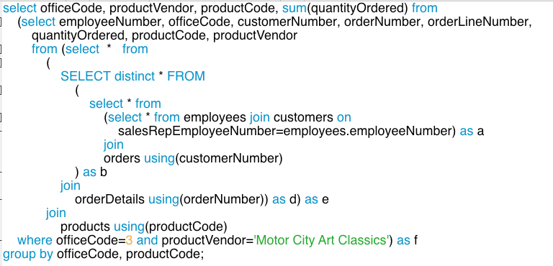
Potential Query

Slide 101
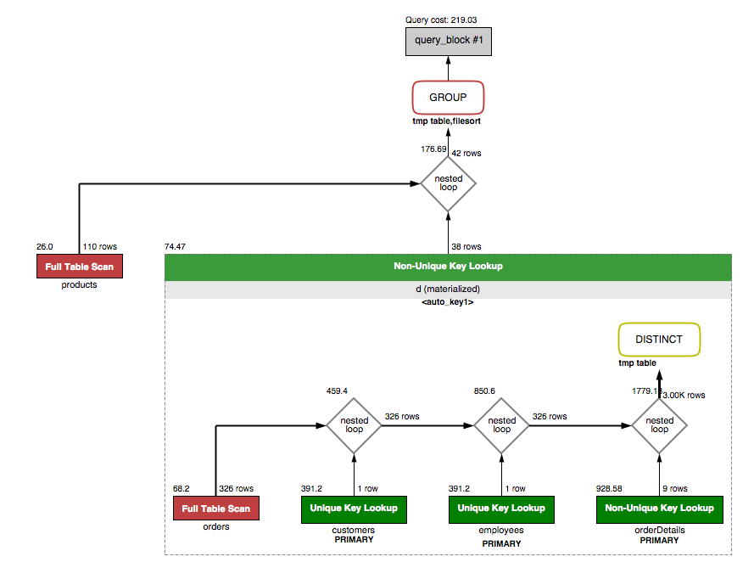
Execution Plan
I am not completely sure that query is correct.
I am sure of two things, however:
I do not want to write queries like this over and over for each question.
The DB engine really, really does not like running queries like this one.

Slide 102
Decision Support versus OLTP

Slide 103
Some Relational OLAP (ROLAP)
103 | Introduction to Databases (S19): Lecture 13: Normalization, Data Analysis

Slide 104
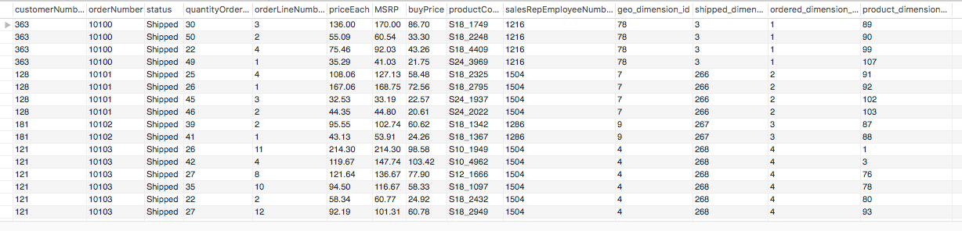
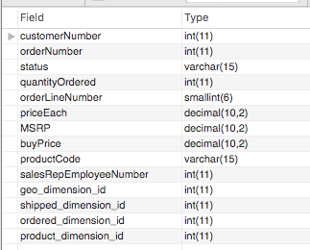
Fact Table
Fact
What was sold.
To whom.
For how much.
And when.
Dimensions tell you how to position in space, time, company structure, your product inventory, ... ...

Slide 105
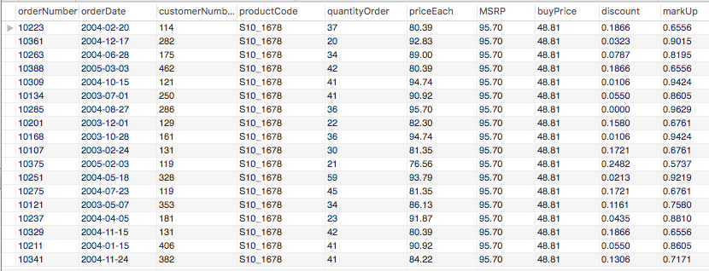
Facts
Orders
OrdersDetails
Products
Computed

Slide 106
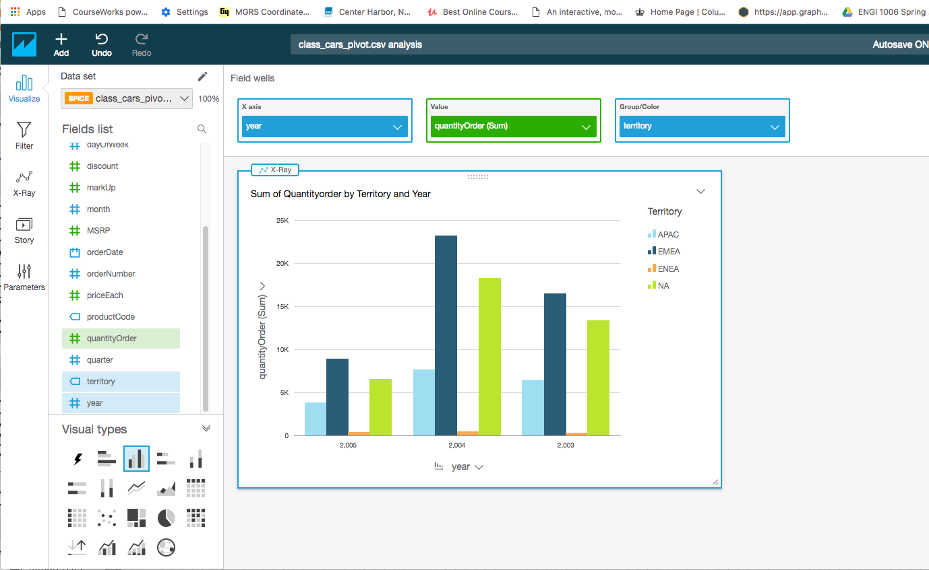
AWS QuickSight: Online BI Service
Filter
Sum of metric:
Metric: quantityOrdered
Dimensions:
Year
Territory
Facts
and
Dimensions

Slide 107
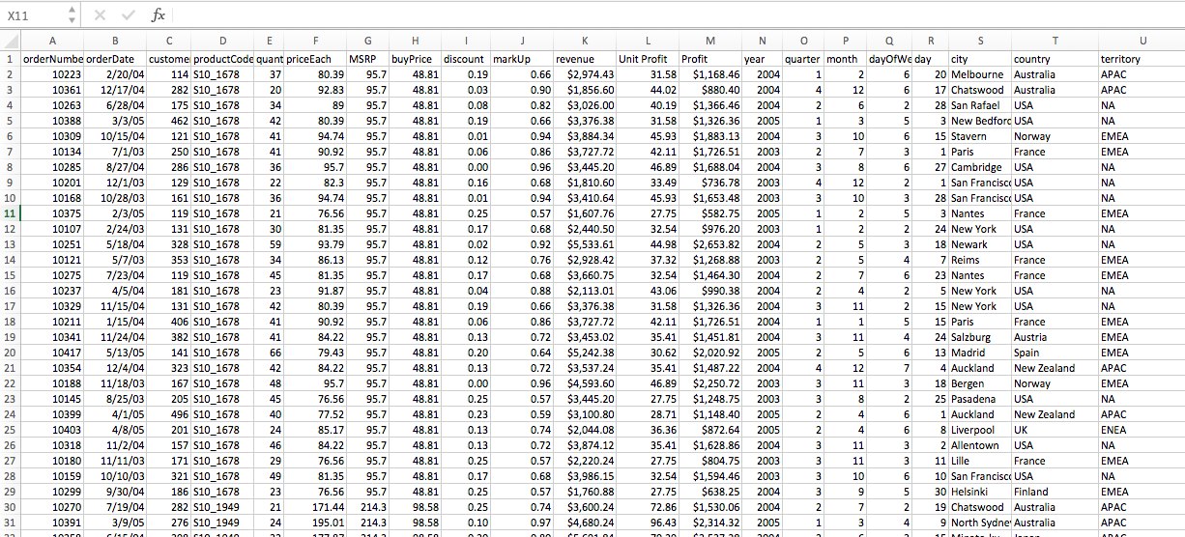
Dimension Examples
Facts and derived facts
Date Dimensions
Geo
Dimension

